Slide 1

CTeSP Tecnologias e Programação de Sistemas de Informação
Segurança Informatica
Filipe André Martins de Freitas

Slide 2
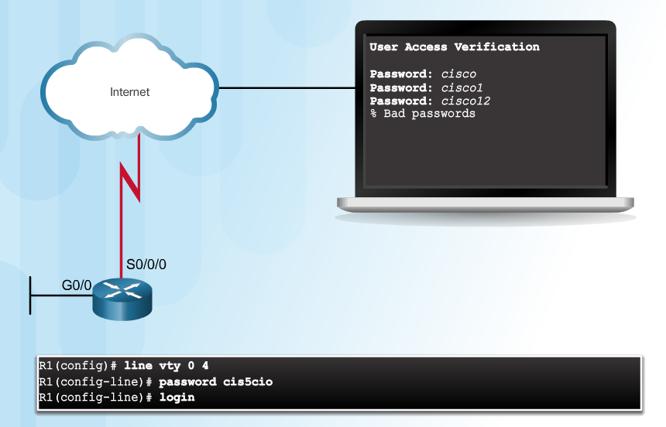
Authentication without AAA
Telnet is Vulnerable to Brute-Force Attacks
Notes:
3.1.1.1 Authentication without AAA

Slide 3
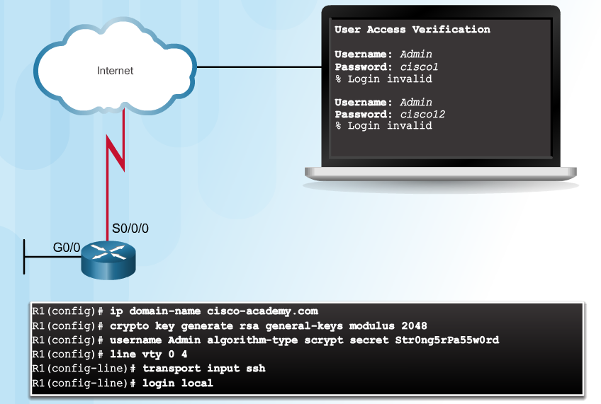
Authentication without AAA (Cont.)
SSH and Local Database Method
Notes:
3.1.1.1 Authentication without AAA

Slide 4
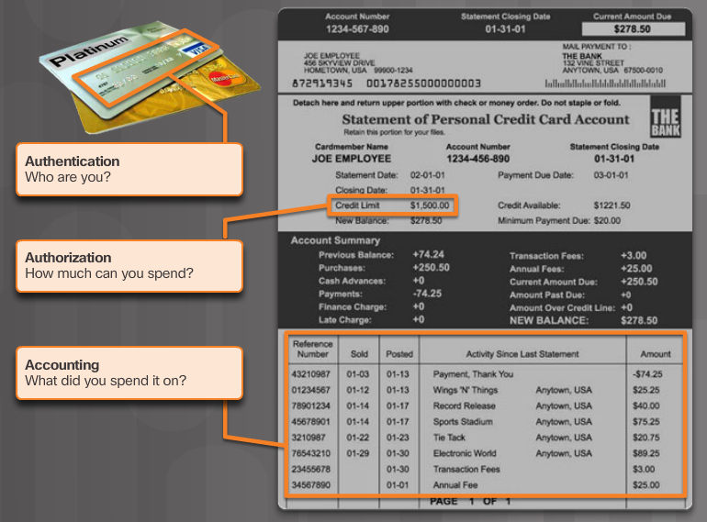
AAA Components
Notes:
3.1.1.2 AAA Components

Slide 5
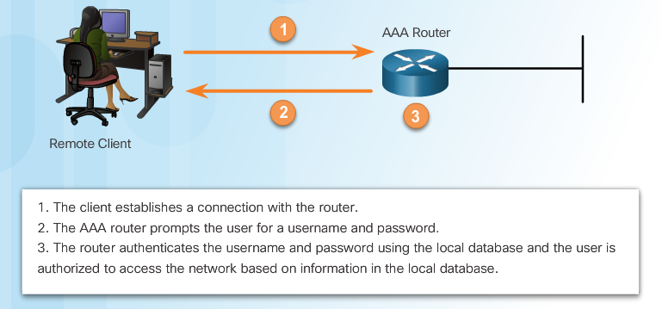
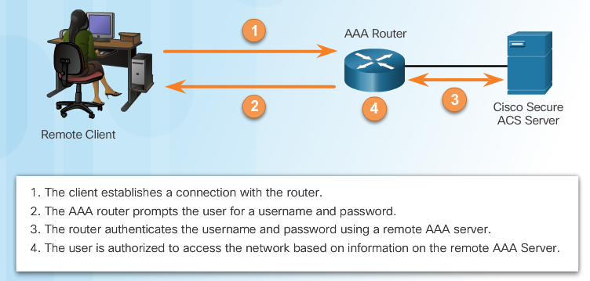
Authentication Modes
Local AAA
Authentication
Server-Based
AAA Authentication
Notes:
3.1.2.1 Authentication Modes

Slide 6
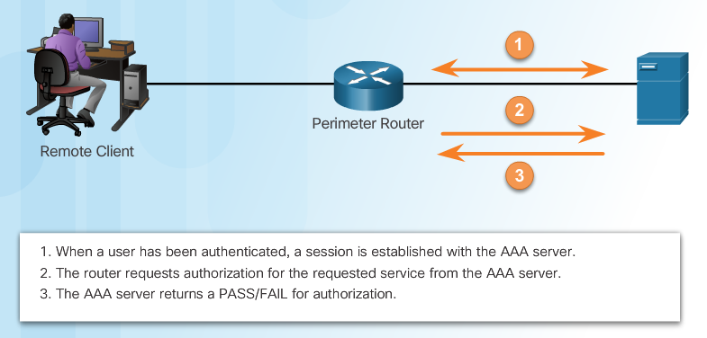
Authorization
AAA Authorization
Notes:
3.1.2.2 Authorization

Slide 7
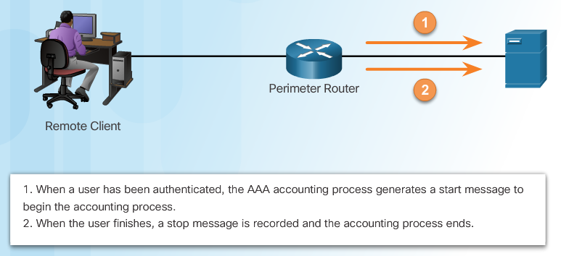
Accounting
Types of accounting information:
Network
Connection
EXEC
System
Command
Resource
AAA Accounting
Notes:
3.1.2.3 Accounting
3.1.2.4 Activity - Indentify the Characteristics of AAA

Slide 8
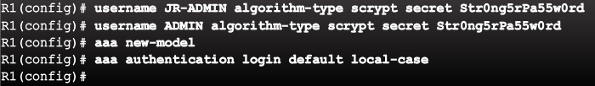
Authenticating Administrative Access
Add usernames and passwords to the local router database for users that need administrative access to the router.
Enable AAA globally on the router.
Configure AAA parameters on the router.
Confirm and troubleshoot the AAA configuration.
Notes:
3.2.1.1 Authenticating Administrative Access

Slide 9
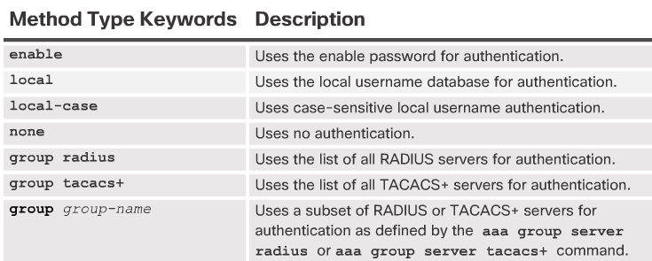
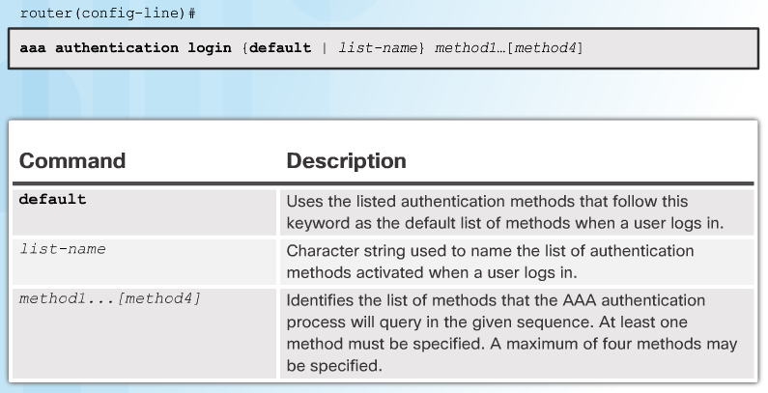
Authentication Methods
Notes:
3.2.1.2 Authentication Methods

Slide 10
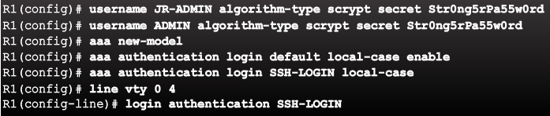
Default and Named Methods
Example Local AAA Authentication
Notes:
3.2.1.3 Default and Named Methods

Slide 11
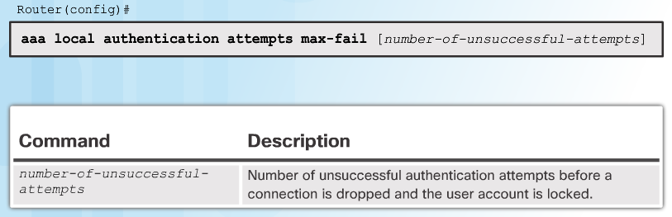

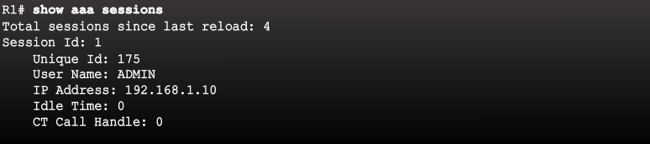
Fine-Tuning the Authentication Configuration
Command Syntax
Display Locked Out Users
Show Unique ID of a Session
Notes:
3.2.1.4 Fine-Tuning the Authentication Configuration

Slide 12
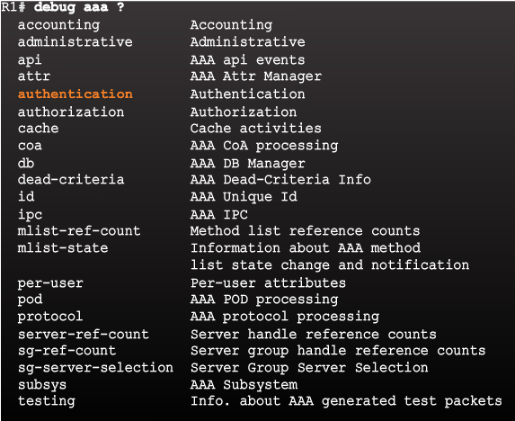
Debug Options
Debug Local AAA Authentication
Notes:
3.2.2.1 Debug Options

Slide 13
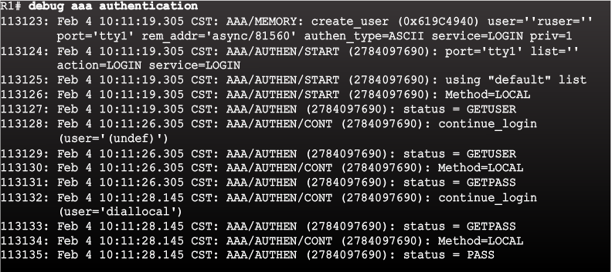
Debugging AAA Authentication
Understanding Debug Output
Notes:
3.2.2.2 Debugging AAA Authentication

Slide 14

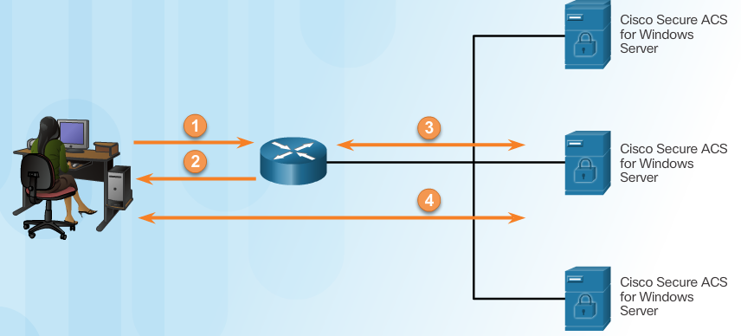
Comparing Local AAA and Server-Based AAA Implementations
Local authentication:
User establishes a connection with the router.
Router prompts the user for a username and password, authentication the user using a local database.
Server-based authentication:
User establishes a connection with the router.
Router prompts the user for a username and password.
Router passes the username and password to the Cisco Secure ACS (server or engine)
The Cisco Secure ACS authenticates the user.
Notes:
3.3.1.1 Comparing Local AAA and Server-Based AAA Implementations

Slide 15
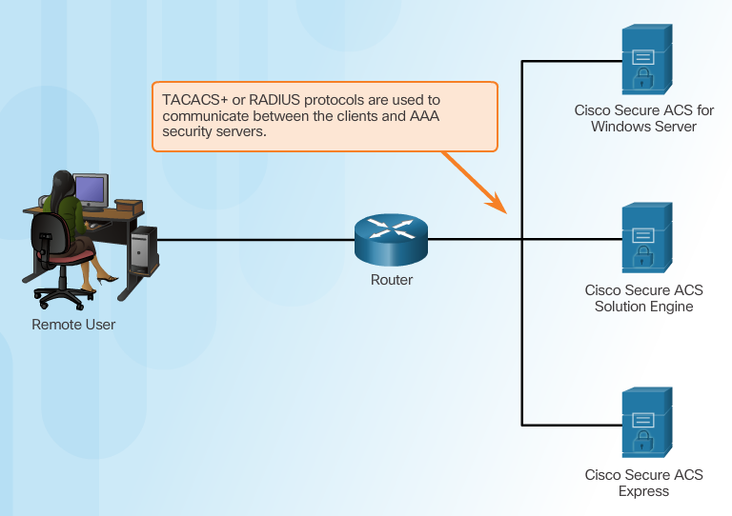
Introducing Cisco Secure Access Control System
Notes:
3.3.1.2 Introducing Cisco Secure Access Control System

Slide 16
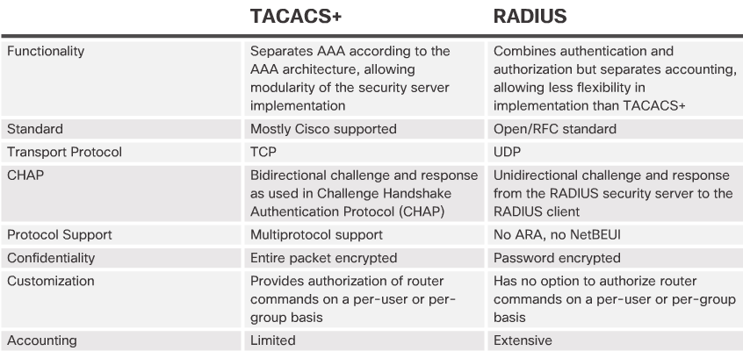
Introducing TACACS+ and RADIUS
Notes:
3.3.2.1 Introducing TACACS+ and RADIUS

Slide 17
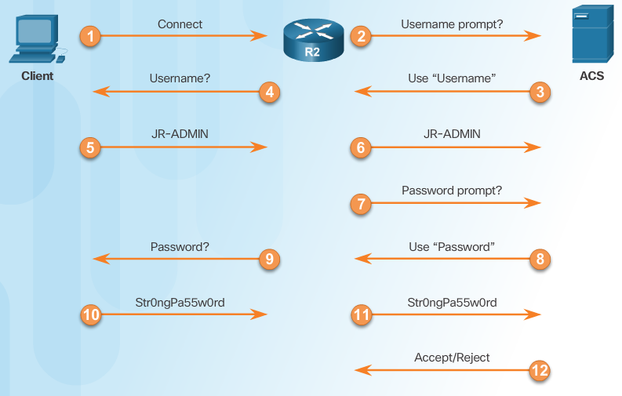
TACACS+ Authentication
TACACS+ Authentication Process
Notes:
3.3.2.2 TACACS+ Authentication

Slide 18
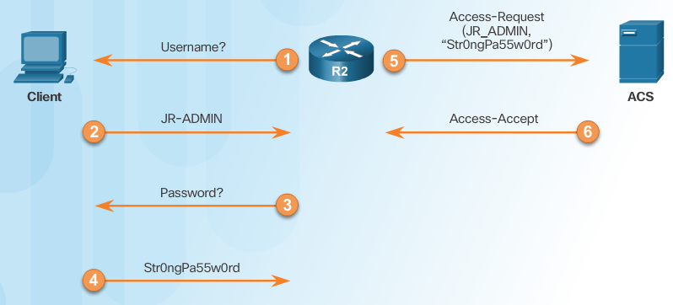
RADIUS Authentication
RADIUS Authentication Process
Notes:
3.3.2.3 RADIUS Authentication

Slide 19
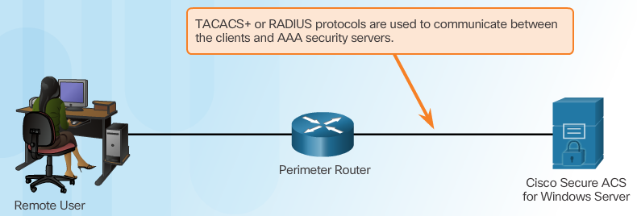
Integration of TACACS+ and ACS
Cisco Secure ACS
Notes:
3.3.2.4 Integration of TACACS+ and ACS

Slide 20
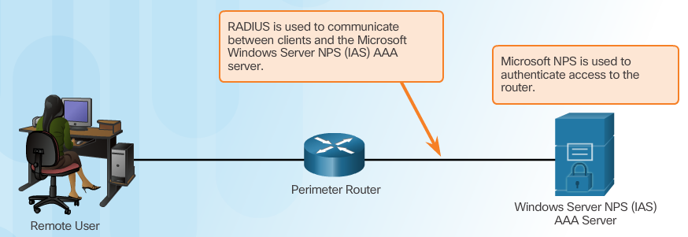
Integration of AAA with Active Directory
Notes:
3.3.2.5 Integration of AAA with Active Directory
3.3.2.6 Video - Integration of AAA with Identity Service Engine
3.3.2.7 Activity - Identify the AAA Communication Protocol

Slide 21
Steps for Configuring Server-Based AAA Authentication with CLI
Enable AAA.
Specify the IP address of the ACS server.
Configure the secret key.
Configure authentication to use either the RADIUS or TACACS+ server.
Notes:
3.4.1.1 Steps for Configuring Server-Based AAA Authentication with CLI

Slide 22
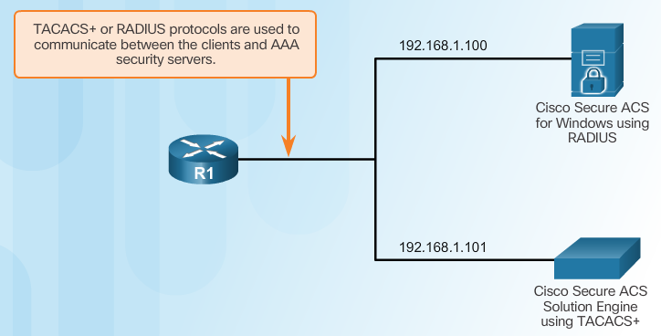
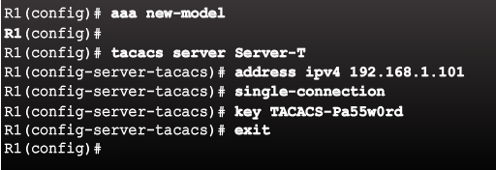
Configuring the CLI with TACACS+ Servers
Server-Based AAA Reference Topology
Configure a AAA TACACS+ Server
Notes:
3.4.1.2 Configuring the CLI for TACACS+ Servers

Slide 23
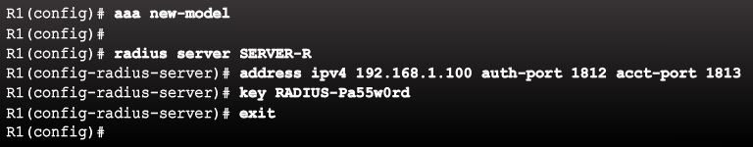
Configuring the CLI for RADIUS Servers
Configure a AAA RADIUS Server
Notes:
3.4.1.3 Configuring the CLI for RADIUS Servers

Slide 24
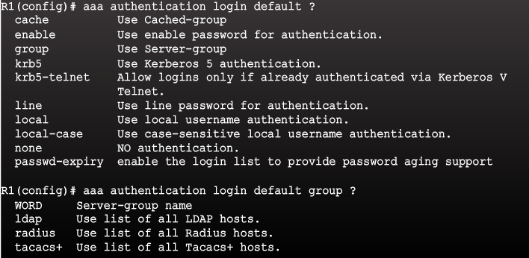
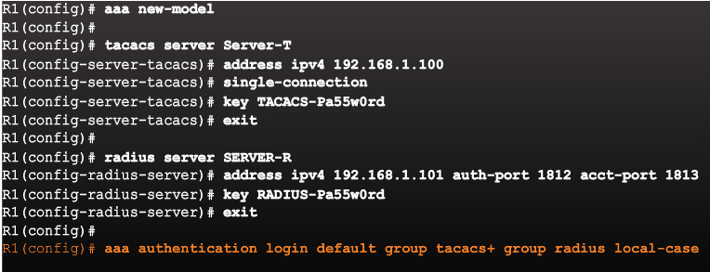
Configure Authentication to Use the AAA Server
Command Syntax
Configure Server-Based AAA Authentication
Notes:
3.4.1.4 Configure Authentication to Use the AAA Server
Syntax Checker - Configure Server-Based AAA Authentication

Slide 25
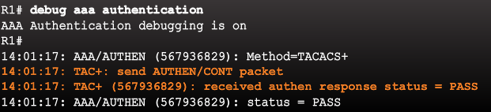
Monitoring Authentication Traffic
Troubleshooting Server-Based AAA Authentication
Notes:
3.4.2.1 Monitoring Authentication Traffic

Slide 26
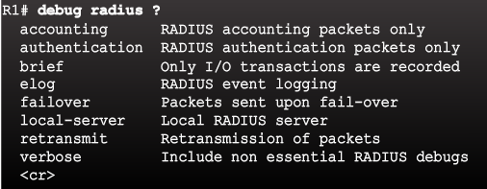
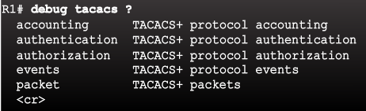
Debugging TACACS+ and RADIUS
Troubleshooting RADIUS
Troubleshooting TACACS+
Notes:
3.4.2.2 Debugging TACACS+ and RADIUS

Slide 27
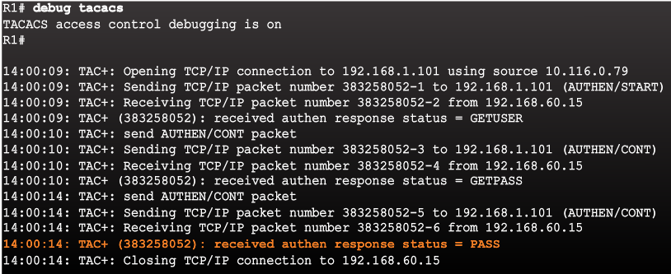
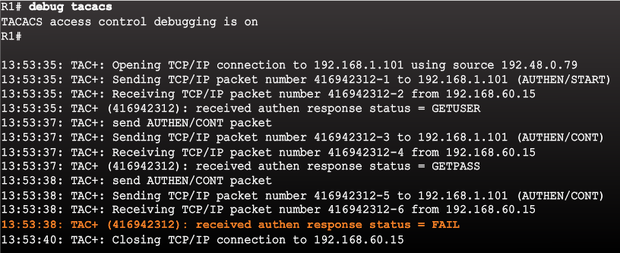
Debugging TACACS+ and RADIUS (Cont.)
AAA Server-Based Authentication Success
AAA Server-Based Authentication Failure
Notes:
3.4.2.2 Debugging TACACS+ and RADIUS (Cont.)
3.4.2.3 Video Demonstration: Configure a Cisco Router to Access a AAA RADIUS Server

Slide 28
Introduction to Server-Based AAA Authorization
Authentication vs. Authorization
Authentication ensures a device or end-user is legitimate
Authorization allows or disallows authenticated users access to certain areas and programs on the network.
TACACS+ vs. RADIUS
TACACS+ separates authentication from authorization
RADIUS does not separate authentication from authorization
Notes:
3.5.1.1 Introduction to Server-Based AAA Authorization

Slide 29
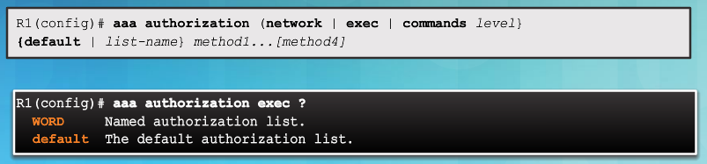
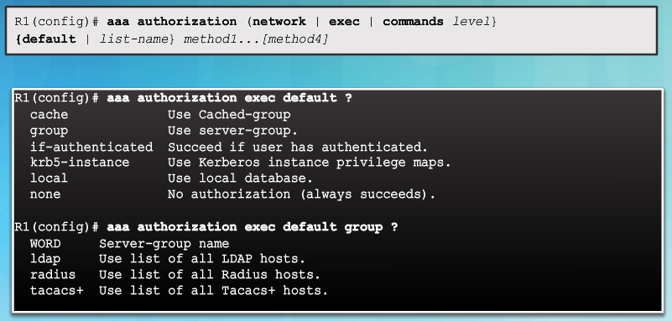
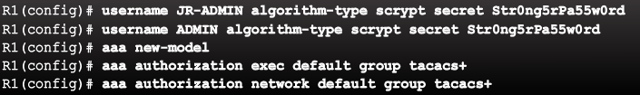
AAA Authorization Configuration with CLI
Command Syntax
Authorization Method Lists
Example AAA Authorization
Notes:
3.5.1.2 AAA Authorization Configuration with CLI

Slide 30
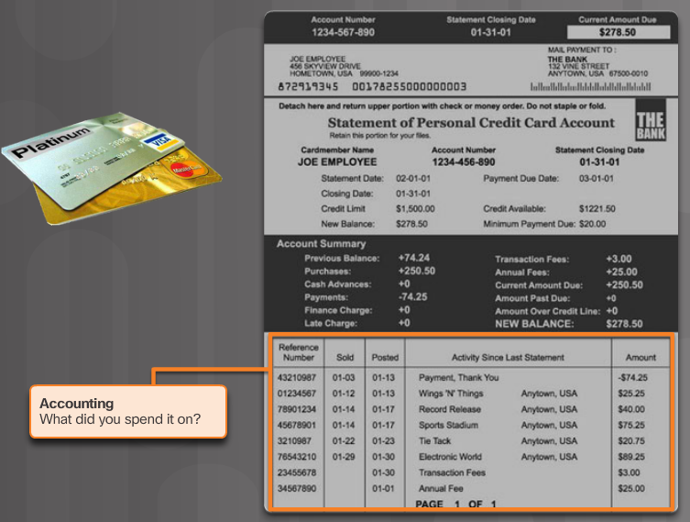
Introduction to Server-Based AAA Accounting
Notes:
3.5.2.1 Introduction to Server-Based AAA Accounting

Slide 31
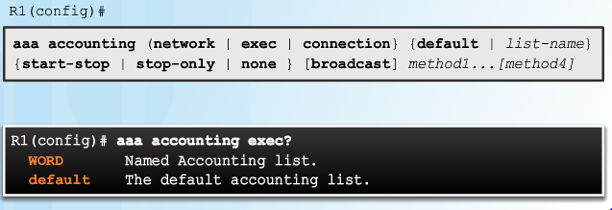
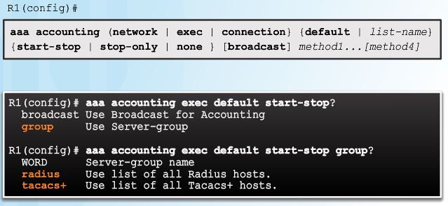
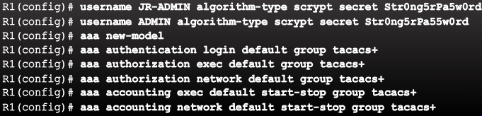
AAA Accounting Configuration with CLI
Command Syntax
Accounting Method Lists
Example AAA Accounting
Notes:
3.5.2.2 AAA Accounting Configuration with CLI
Syntax Checker - Configure AAA Accounting

Slide 32
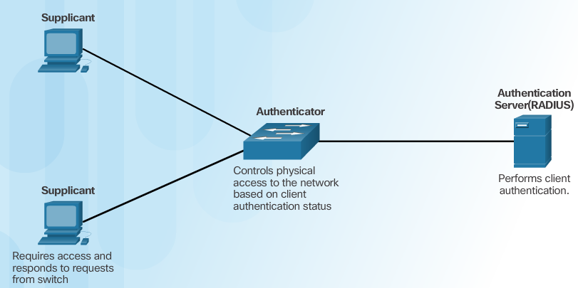
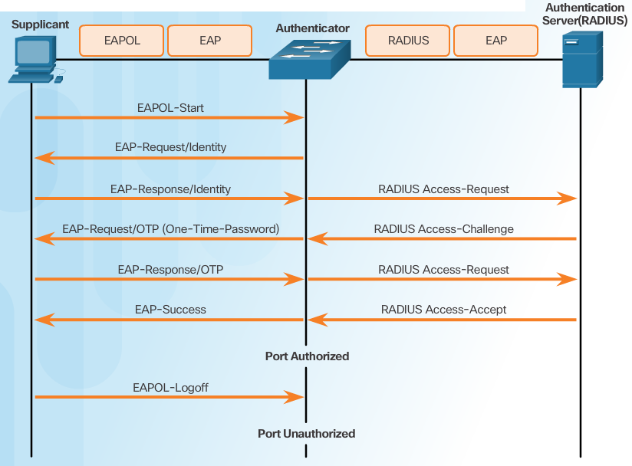
Security Using 802.1X Port-Based Authentication
802.1X Roles
802.1X Message Exchange
Notes:
3.5.3.1 Security Using 802.1X Port-Based Authentication

Slide 33
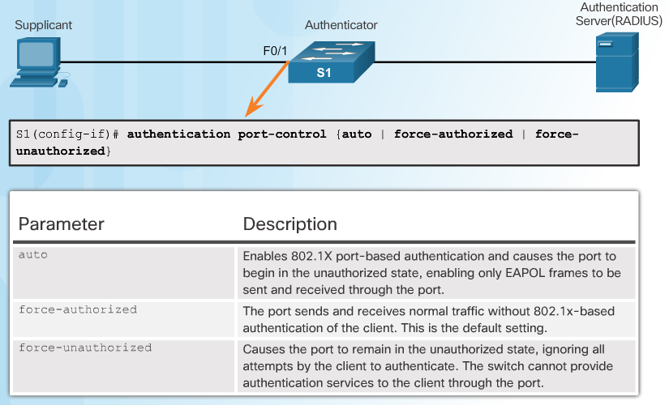
802.1X Port Authorization State
Command Syntax for dot1x port-control
Notes:
3.5.3.2 802.1X Port Authorization State

Slide 34
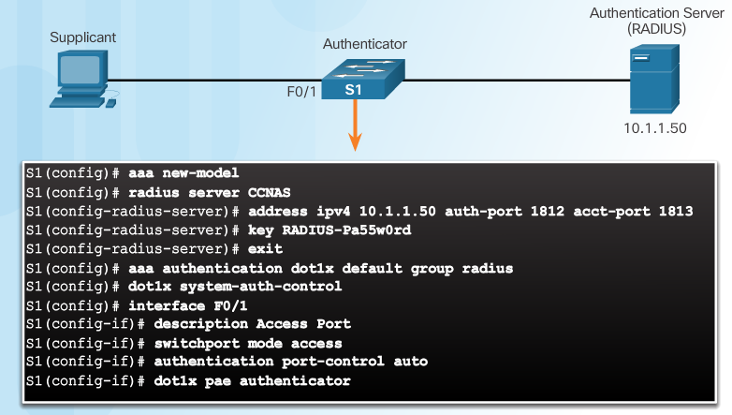
Configuring 802.1X
Notes:
3.5.3.3 Configuring 802.1X
Syntax Checker - Configure 802.1X Port-Authentication on a 2960 Switch
3.6.1.1 Packet Tracer - Configure Authentication on Cisco Routers
3.6.1.2 Lab - Securing Administrative Access Using AAA and RADIUS

Slide 35
DÚVIDAS ?!

Slide 36


